Slide 1



Lecture 3c
Convolutional Neural Networks
Master in Big Data Solutions 2020-2021 - Artificial Intelligence
Xavier Giró
xavier.giro@bts.tech

Slide 2




Acknowledgements
Míriam Bellver
miriam.bellver@bsc.edu
PhD Candidate
Barcelona Supercomputing Center
Kevin McGuinness
kevin.mcguinness@dcu.ie
Research Fellow
Insight Centre for Data Analytics
Dublin City University

Slide 3
Outline
Architecture
Interpretability
Computation
Receptive Fields
Convoluzionization
Applications

Slide 4
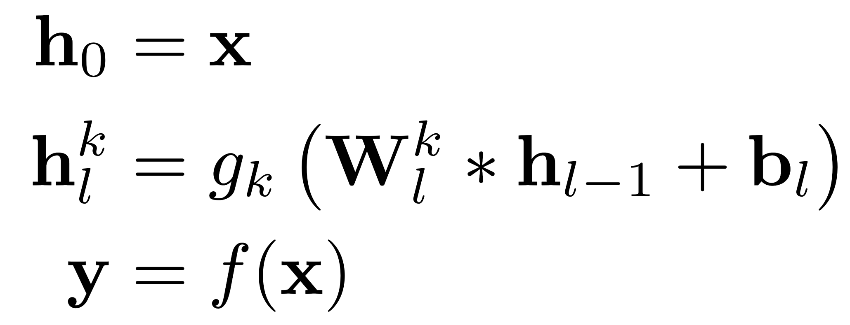
Convolutional Network
Input data
Convolutional Layer l
(k^{th} channel)
Output data
Convolutional operator

Slide 5

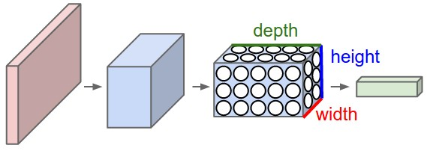
ConvNets Architecture
Multi-Layer Perceptron
Convolutional Neural Net
Figure: Fei-Fei Li et al, “CS231n: Convolutional Neural Networks for Visual Recognition”, Stanford University.

Slide 6
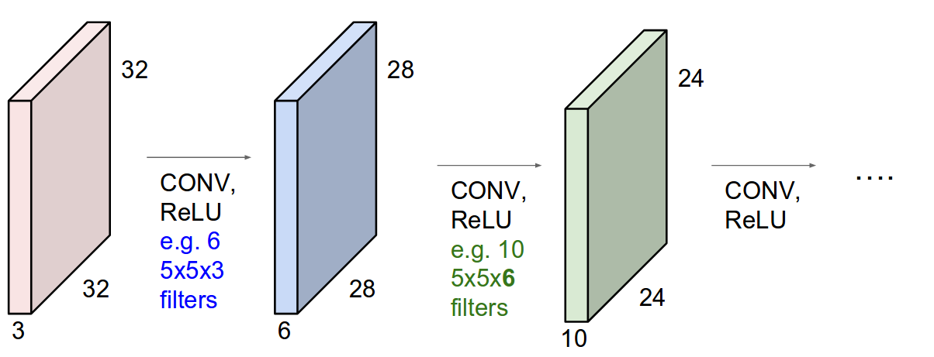
ConvNets Architecture
A ConvNet is a sequence of Convolution Layers, interspersed with activation functions
Figure: Fei-Fei Li et al, “CS231n: Convolutional Neural Networks for Visual Recognition”, Stanford University.

Slide 7
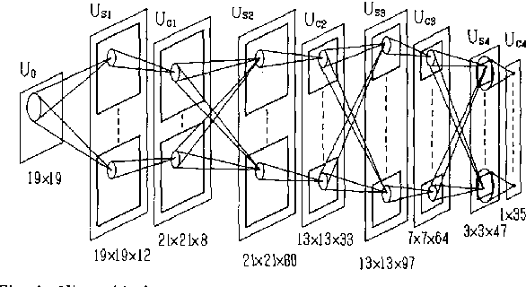
Neocognitron (predecessor)
#Neocognitron Fukushima, K., & Wake, N. (1991). Handwritten alphanumeric character recognition by the neocognitron. IEEE transactions on Neural Networks, 2(3), 355-365.

Slide 8
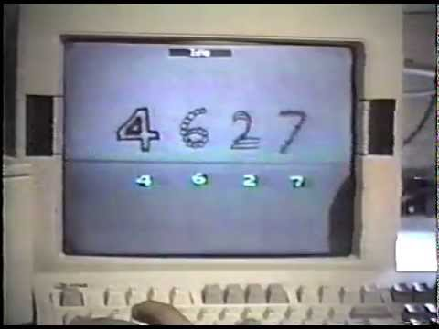
ConvNets Architecture
LeNet-1, the first convolutional network that could recognize handwritten digits with good speed and accuracy. Developed between 1988 and 1993 in the Adaptive System Research Department, headed by Larry Jackel, at Bell Labs in Holmdel, NJ, USA:

Slide 9

ConvNets Architecture
LeNet-5: The most typical architecture consists on several convolutional layers, interspersed with pooling layers, and followed by a small number of fully connected layers
#LeNet LeCun, Y., Bottou, L., Bengio, Y., & Haffner, P. Gradient-based learning applied to document recognition. Proceedings of the IEEE, 1998.

Slide 10
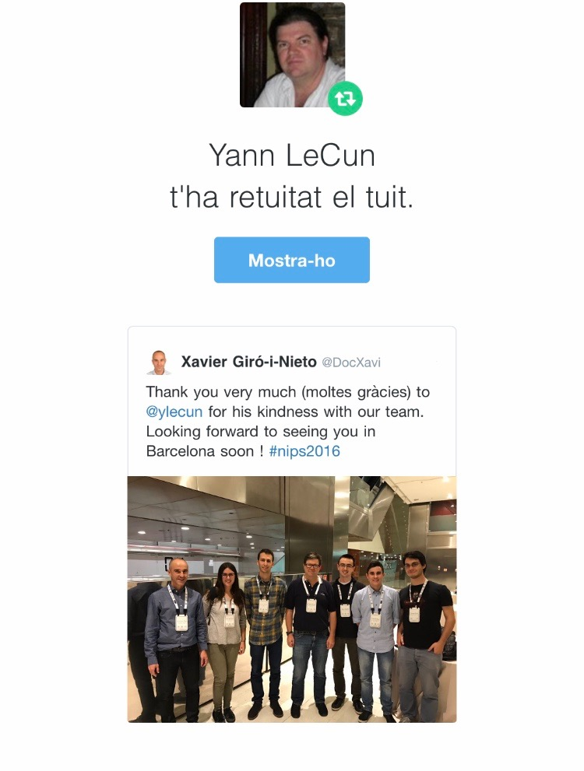



ConvNets Architecture
Yann LeCun
You can also
check @boredyannlecun
on Twitter...

Slide 11
Convolution in Color Images (eg. RGB, YCBCr...)
A 5x5 convolution on a volume of depth 3 (e.g. an image) needs a filter (kernel) with 5x5x3 elements (weights) + a bias.
Kernels move along 2 dimensions, that’s why these are 2D convolutions as well.
32
5
5
32
3
Figure: Fei-Fei Li et al, “CS231n: Convolutional Neural Networks for Visual Recognition”, Stanford University.

Slide 12
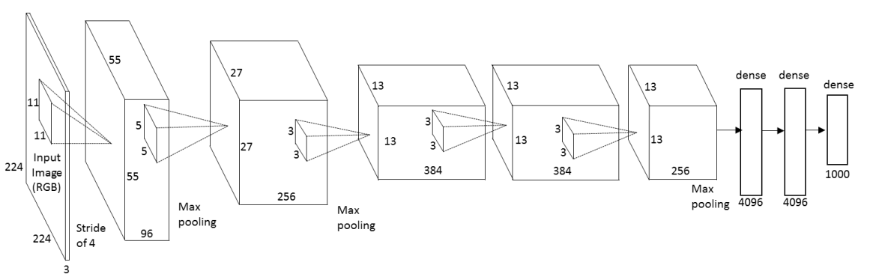
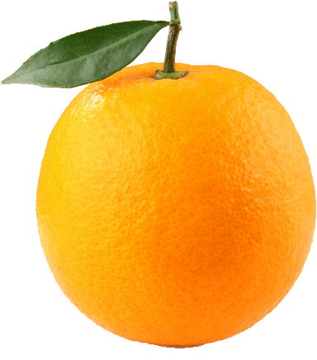
ConvNets in Color Images (eg. RGB, YCBCr...)
#AlexNet Krizhevsky, Alex, Ilya Sutskever, and Geoffrey E. Hinton. "Imagenet classification with deep convolutional neural networks." NIPS 2012

Slide 13
Outline
Architecture
Interpretability
Computation
Receptive Fields
Convoluzionization
Applications

Slide 14
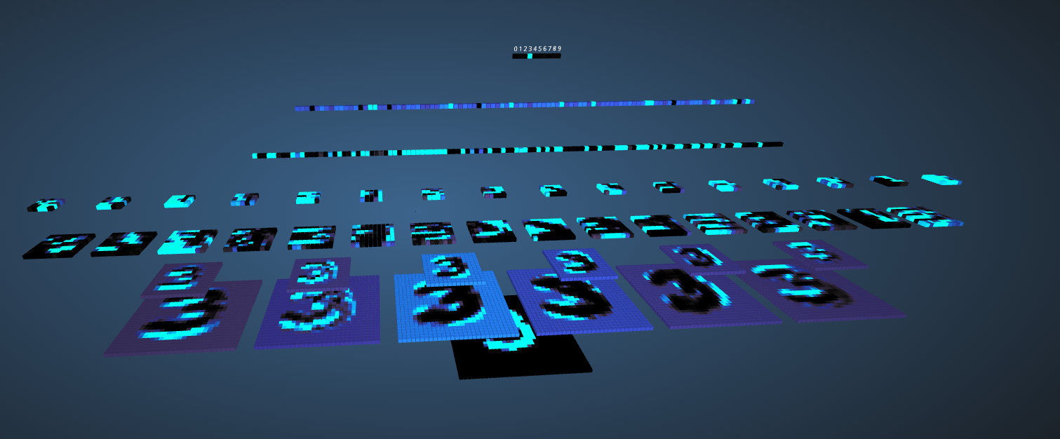
ConvNets Architecture
Demo: 3D Visualization of a Convolutional Neural Network
Harley, Adam W. "An Interactive Node-Link Visualization of Convolutional Neural Networks." In Advances in Visual Computing, pp. 867-877. Springer International Publishing, 2015.

Slide 15

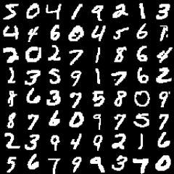


ConvNets Architecture
Demo: Classify MNIST digits with a Convolutional Neural Network
“ConvNetJS is a Javascript library for training Deep Learning models (mainly Neural Networks) entirely in your browser. Open a tab and you're training. No software requirements, no compilers, no installations, no GPUs, no sweat.”

Slide 16
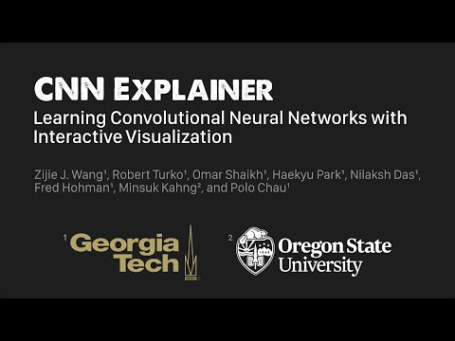
#CNNExplainer Wang, Z. J., Turko, R., Shaikh, O., Park, H., Das, N., Hohman, F., ... & Chau, D. H. (2020). CNN Explainer: Learning Convolutional Neural Networks with Interactive Visualization. IEEE VIS 2020.

Slide 17
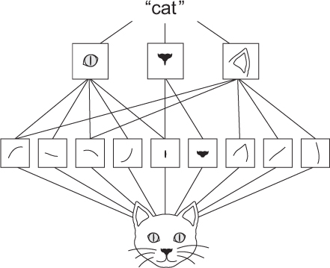
Why using CNNs for images?
The patterns they learn are translation invariant:
Each filter will learn to detect a certain pattern, that can be recognized in any location of the image. Then these filters are translation invariant. This is data efficient, and with less training samples CNNs can learn representations that can generalize.
They can learn hierarchies of patterns.
A first convolutional layer will learn small local patterns, and the following convolutional layers will learn larger patterns made of features of the first layers, and so on. Then convnets can learn complex and abstract visual concepts.
Figure: François Chollet, ”Deep Learning with Python”, Mannnig Publications 2017.

Slide 18
Outline
Architecture
Interpretability
Computation
Receptive Fields
Convoluzionization
Applications

Slide 19
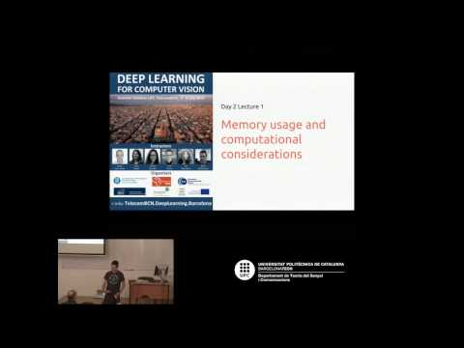
Outline
Architecture
Interpretability
Computation
Memory
Receptive Fields
Convoluzionization
Applications
Kevin McGuinness, “Deep Learning for Computer Vision”,
UPC TelecomBCN Barcelona 2016

Slide 20
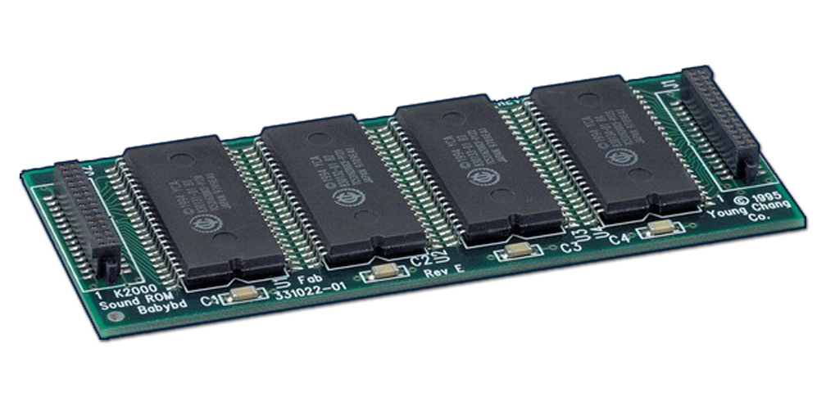
Calculating memory requirements
Often the size of the network will be practically bound by available memory
Useful to be able to estimate memory requirements of network
True memory usage depends on the implementation
Slide: Kevin McGuinness, “Deep Learning for Computer Vision”, UPC TelecomBCN Barcelona 2016. [video]

Slide 21
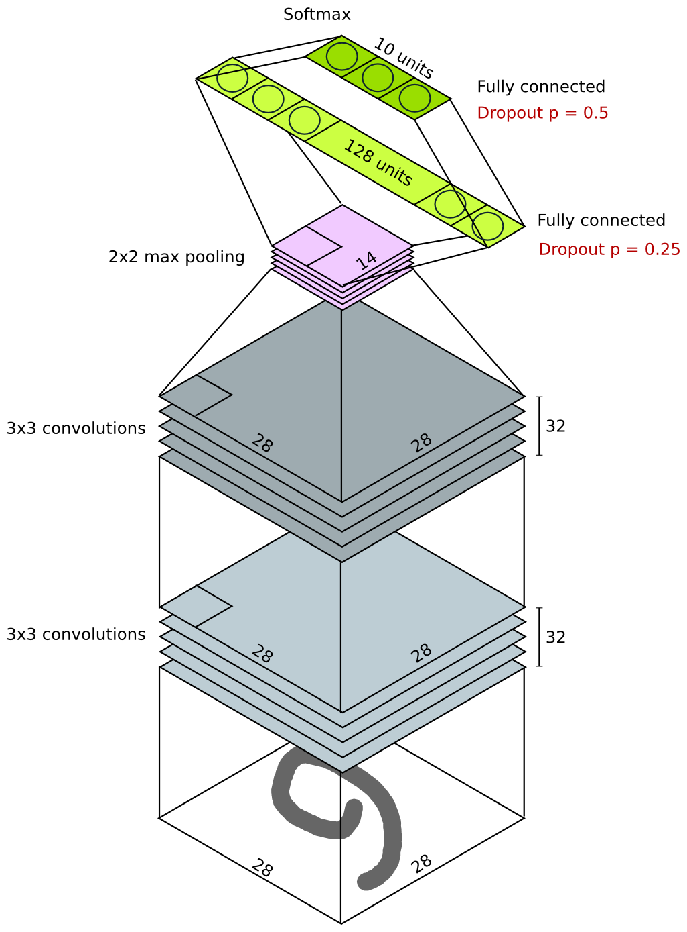
Calculating the model size
Conv layers:
Num weights on conv layers does not depend on input size (weight sharing)
Depends only on depth, kernel size, and depth of previous layer

Slide 22
Calculating the model size
parameters
weights: depth_{n} x (kernel_{w} x kernel_{h}) x depth_{(n-1)}
biases: depth_{n}

Slide 23
Calculating the model size
parameters
weights: 32 x (3 x 3) x 1 = 288
biases: 32

Slide 24
Calculating the model size
parameters
weights: 32 x (3 x 3) x 32 = 9216
biases: 32

Slide 25
Calculating the model size
Pooling layers are parameter-free

Slide 26
Calculating the model size
Fully connected layers
#weights = #outputs x #inputs
#biases = #outputs
If previous layer has spatial extent (e.g. pooling or convolutional), then #inputs is size of flattened layer.

Slide 27
Calculating the model size
parameters
weights: #outputs x #inputs
biases: #inputs

Slide 28
Calculating the model size
parameters
weights: 128 x (14 x 14 x 32) = 802816
biases: 128

Slide 29
Calculating the model size
parameters
weights: 10 x 128 = 1280
biases: 10

Slide 30
Total model size
parameters
weights: 10 x 128 = 1280
biases: 10
parameters
weights: 128 x (14 x 14 x 32) = 802816
biases: 128
parameters
weights: 32 x (3 x 3) x 32 = 9216
biases: 32
parameters
weights: 32 x (3 x 3) x 1 = 288
biases: 32
Total: 813,802
~ 3.1 MB (32-bit floats)

Slide 31
Feature map sizes
Easy…
Conv layers: width x height x depth
FC layers: #outputs
32 x (14 x 14) = 6,272
32 x (28 x 28) = 25,088

Slide 32
Total memory requirements (train time)
Depends on implementation and optimizer
Memory for parameters
Memory for layer outputs
Memory for param gradients
Memory for layer error
Memory for momentum
Implementation overhead (memory for convolutions, etc.)
Slide: Kevin McGuinness, “Deep Learning for Computer Vision”, UPC TelecomBCN Barcelona 2016. [video]

Slide 33
Total memory requirements (test time)
Depends on implementation and optimizer
Memory for parameters
Memory for layer outputs
Memory for param gradients
Memory for layer error
Memory for momentum
Implementation overhead (memory for convolutions, etc.)
Slide: Kevin McGuinness, “Deep Learning for Computer Vision”, UPC TelecomBCN Barcelona 2016. [video]

Slide 34
Outline
Architecture
Interpretability
Computation
Operations
Receptive Fields
Convoluzionization
Applications

Slide 35
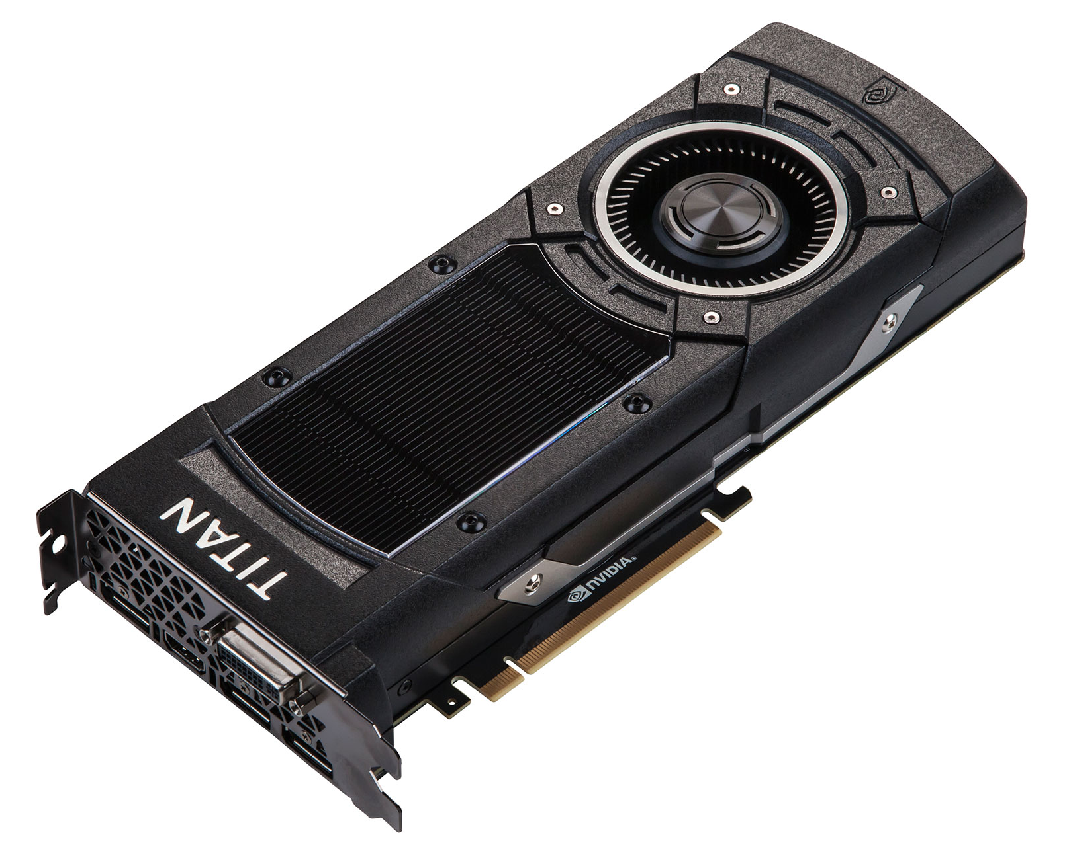
Estimating computational complexity
Useful to be able to estimate computational complexity of an architecture when designing it
Computation in deep NN is dominated by multiply-adds in FC and conv layers.
Typically we estimate the number of FLOPs (multiply-adds) in the forward pass
Ignore non-linearities, dropout, and normalization layers (negligible cost).
Slide: Kevin McGuinness, “Deep Learning for Computer Vision”, UPC TelecomBCN Barcelona 2016. [video]

Slide 36
Estimating computational complexity
Fully connected layer FLOPs
Easy: equal to the number of weights (ignoring biases)
= #num_inputs x #num_outputs
Convolution layer FLOPs
Product of:
Spatial width of the map
Spatial height of the map
Previous layer depth
Current layer depth
Kernel width
Kernel height
Slide: Kevin McGuinness, “Deep Learning for Computer Vision”, UPC TelecomBCN Barcelona 2016. [video]

Slide 37
Example: VGG-16 architecture
Bulk of computation is here
Layer | H | W | kernel H | kernel W | depth | repeats | FLOP/s
input | 224 | 224 | 1 | 1 | 3 | 1 | 0.00E+00
conv1 | 224 | 224 | 3 | 3 | 64 | 2 | 1.94E+09
conv2 | 112 | 112 | 3 | 3 | 128 | 2 | 2.77E+09
conv3 | 56 | 56 | 3 | 3 | 256 | 3 | 4.62E+09
conv4 | 28 | 28 | 3 | 3 | 512 | 3 | 4.62E+09
conv5 | 14 | 14 | 3 | 3 | 512 | 3 | 1.39E+09
flatten | 1 | 1 | 0 | 0 | 100352 | 1 | 0.00E+00
fc6 | 1 | 1 | 1 | 1 | 4096 | 1 | 4.11E+08
fc7 | 1 | 1 | 1 | 1 | 4096 | 1 | 1.68E+07
fc8 | 1 | 1 | 1 | 1 | 100 | 1 | 4.10E+05
 |  |  |  |  |  |  | 1.58E+10
Slide: Kevin McGuinness, “Deep Learning for Computer Vision”, UPC TelecomBCN Barcelona 2016. [video]

Slide 38
Outline
Architecture
Interpretability
Computation
Receptive Fields
Convoluzionization
Applications

Slide 39
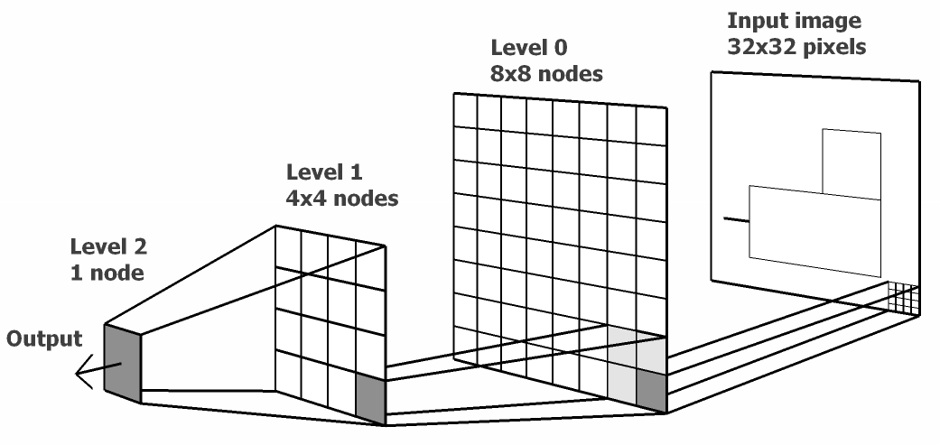
Receptive Field
Receptive field: Part of the input that is visible to a neuron. It increases as we stack more convolutional layers (i.e. neurons in deeper layers have larger receptive fields).
Figure: Saulius Garalevicius

Slide 40
Receptive Field (1D Conv)
1
2nd Conv Layer
K=3
1 | 2 | 3 | 4
Depth
1st Conv Layer
K=3
Input Layer
1 | 2 | 3 | 4 | 5 | 6

Slide 41
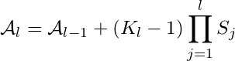
Receptive Field
Useful to be able to compute how far a convolutional node in a convnet sees:
Size of the input pixel patch that affects a node’s output
Known as the effective aperture size, coverage, or receptive field size
Depends on kernel size and strides from previous layers
7x7 kernel can see a 7x7 patch of the layer below
Stride of 2 doubles what all layers after can see
Calculate recursively

Slide 42
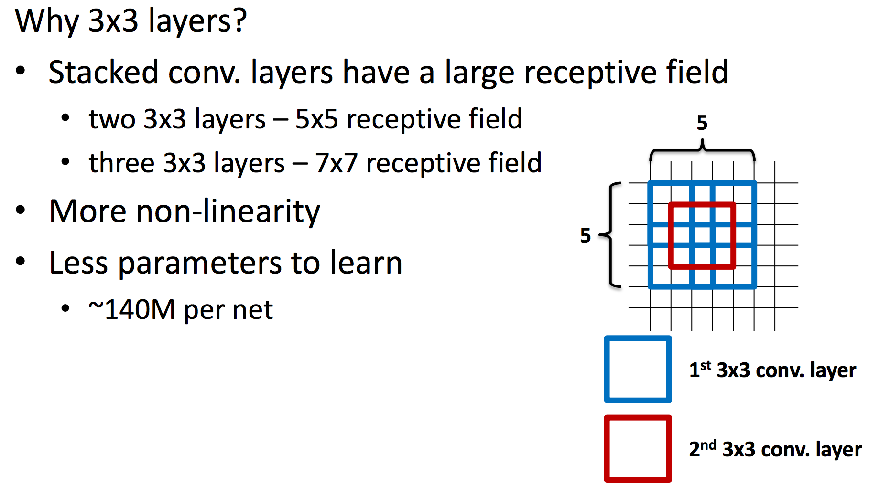
Receptive Field & Stacked Convolutions
#VGG Simonyan, Karen, and Andrew Zisserman. "Very deep convolutional networks for large-scale image recognition." ICLR 2015. [video] [slides] [project]

Slide 43
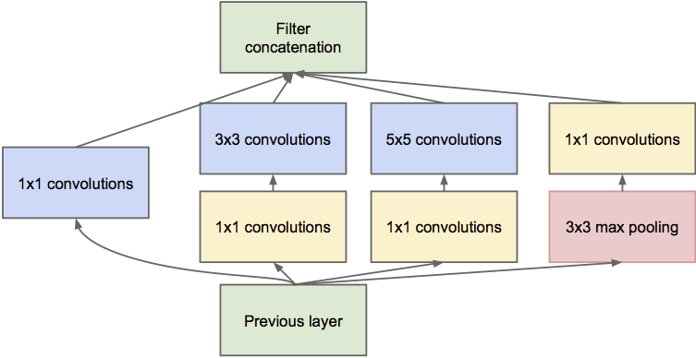
Receptive Field & Inception Modules
#NiN Lin, Min, Qiang Chen, and Shuicheng Yan. "Network in network." ICLR 2014.

Slide 44


Receptive Field & Pooling Layer
now, a filter of 2x2 will see a bigger patch of the input image! Receptive field will be bigger, and learn more abstract concepts!
Figure Credit, CS231n Course

Slide 45
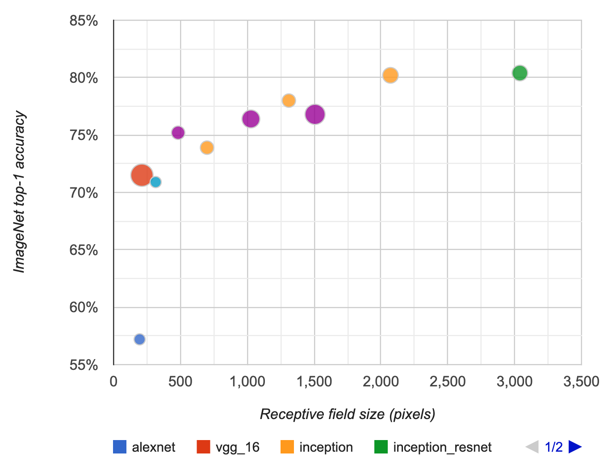


Receptive Field
Larger receptive field is related to the performance of computer vision models.
Problem: Receptive field may be limited, and pixel-wise predictions at the deepest layer may not be aware of the whole image.
André Araujo, Wade Norris, Jack Sim, “Computing Receptive Fields of Convolutional Neural Networks”. Distill.pub 2019.

Slide 46

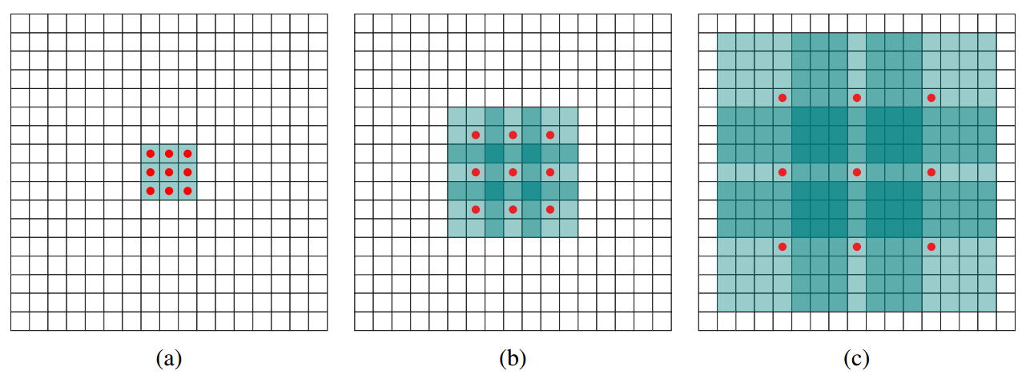
Dilated Convolutions
By adding more layers:
The receptive field grows exponentially.
The number of learnable parameters (filter weights) grows linearly.
Yu, F., & Koltun, V. (2015). Multi-scale context aggregation by dilated convolutions. ICLR 2016.

Slide 47

Dilated Convolutions
OUTPUT
INPUT
Vincent Dumoulin, Francesco Visin, “A guide to convolution arithmetic for deep learning”, arXiv 2016. [code]

Slide 48
Outline
Architecture
Interpretability
Computation
Receptive Fields
Convoluzionization
Applications

Slide 49
Convoluzionization
A neuron in a fully connected layer is equivalent to a convolutional neuron with as many weights as input values from the previous layer.
3x2x2 tensor
(RGB image of 2x2)
2 fully connected neurons
2 convolutional filters of 3 x 2 x 2
(same size as input tensor)
3x2x2 * 2 weights
3x2x2 * 2 weights

Slide 50
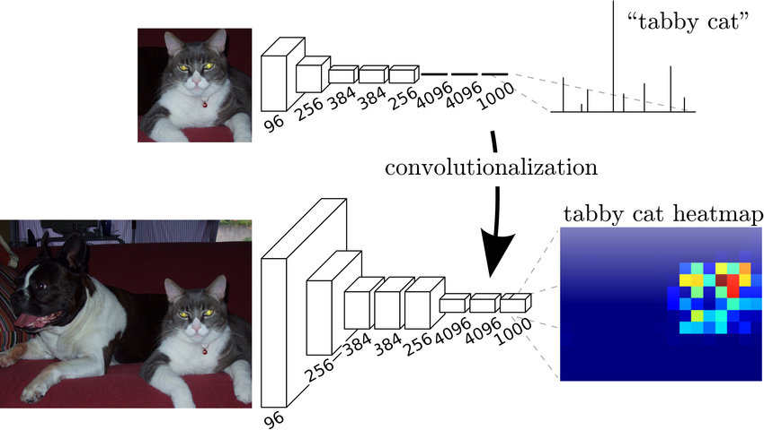
Convoluzionization
...a model trained for image classification on low-definition images can provide local response when fed with high-definition images.
Long, Jonathan, Evan Shelhamer, and Trevor Darrell. "Fully convolutional networks for semantic segmentation." CVPR 2015. (original figure has been modified)

Slide 51
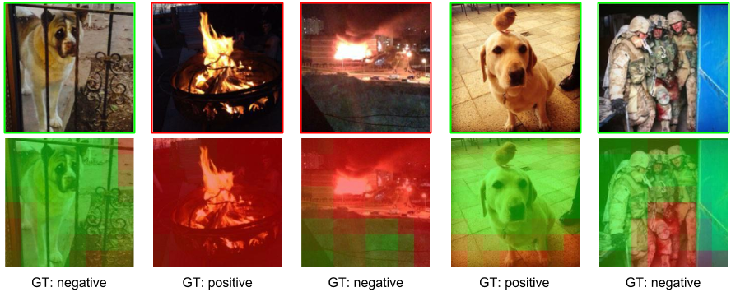

Convoluzionization
The FC to Conv redefinition allows generating heatmaps of the class prediction over the input images.
Campos, V., Jou, B., & Giro-i-Nieto, X. . From Pixels to Sentiment: Fine-tuning CNNs for Visual Sentiment Prediction. Image and Vision Computing. (2017)

Slide 52
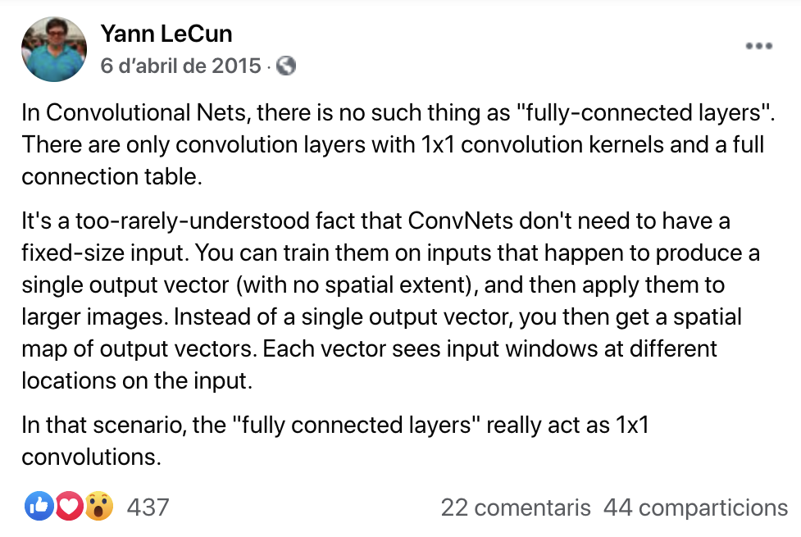
Convoluzionization

Slide 53
Outline
Architecture
Interpretability
Computation
Receptive Fields
Convoluzionization
Applications

Slide 54
Convolutional neural networks
Is this exclusive to images?
NO!!
Convolutional Neural Networks have been proved to work well for other kinds of signals (text, speech…) as they are computationally very efficient and can learn very useful representations!

Slide 55
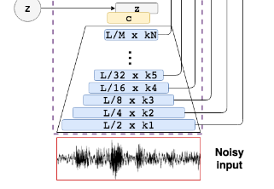

Speech Encoding
#SEGAN Pascual, Santiago, Antonio Bonafonte, and Joan Serra. "SEGAN: Speech enhancement generative adversarial network." Interspeech 2017.

Slide 56
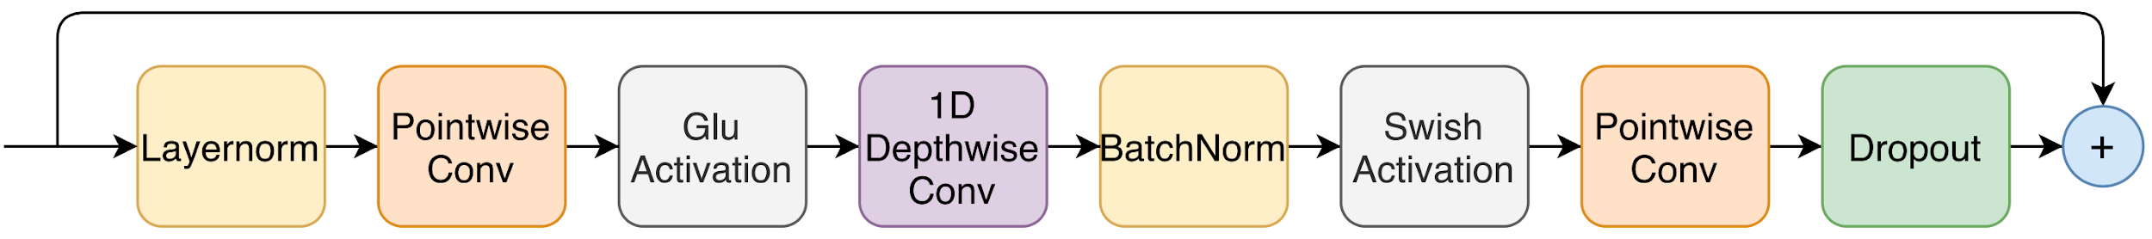
Speech Recognition
#Conformer Gulati, A., Qin, J., Chiu, C. C., Parmar, N., Zhang, Y., Yu, J., ... & Pang, R. (2020). Conformer: Convolution-augmented Transformer for Speech Recognition. arXiv preprint arXiv:2005.08100.
Notes:
: Convolution module. The convolution module contains a pointwise convolution with an expansion factor of 2 projecting the number of channels with a GLU activation layer, followed by a 1-D Depthwise convolution. The 1-D depthwise conv is followed by a Batchnorm and then a swish activation layer

Slide 57
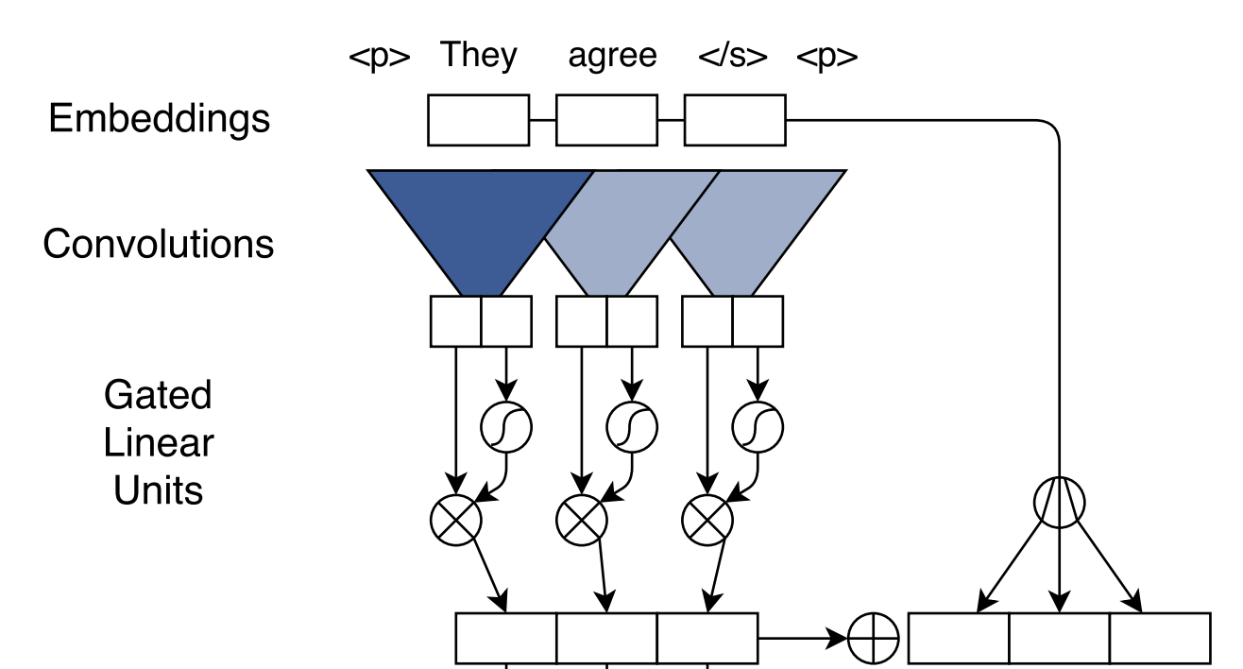
Text Encoding
Gehring, Jonas, Michael Auli, David Grangier, Denis Yarats, and Yann N. Dauphin. "Convolutional sequence to sequence learning." ICML 2017.

Slide 58
Outline
Architecture
Interpretability
Computation
Receptive Fields
Convoluzionization
Applications

Slide 59

Learn more
Deep Learning TV, “Convolutional Neural Networks - Ep. 8”

Slide 60

Learn more
Sander Dieleman, “The Deep Learning Lecture Series”, UCL (2020)

Slide 61
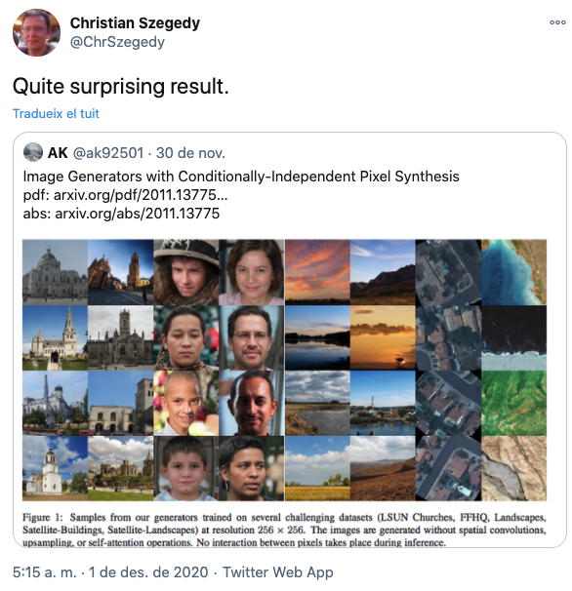
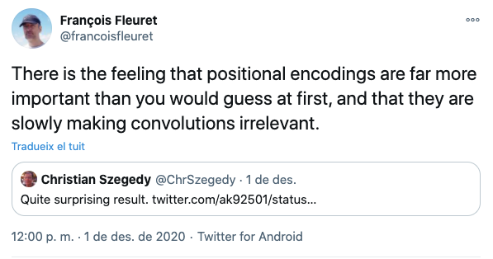
The end of convolutional layers ?

Slide 62
Learn more
Jordi Pons, “Convolutional neural networks”. 2020.
Lecture notes by Andrej Karpathy (Stanford)
Fan, Y., Xian, Y., Losch, M. M., & Schiele, B. (2020). Analyzing the Dependency of ConvNets on Spatial Information. arXiv preprint arXiv:2002.01827.
Ed Wagstaff & Fabian Fuchs, “Group CNNs”
Islam, M. A., Jia, S., & Bruce, N. D. (2020). How much Position Information Do Convolutional Neural Networks Encode?. ICLR 2020. [tweet1] [tweet2]
Vinee Pratap, Ronan Collobert, Online speech recognition with wav2letter@anywhere. Facebook AI (2020)

Slide 63


